Slide 1
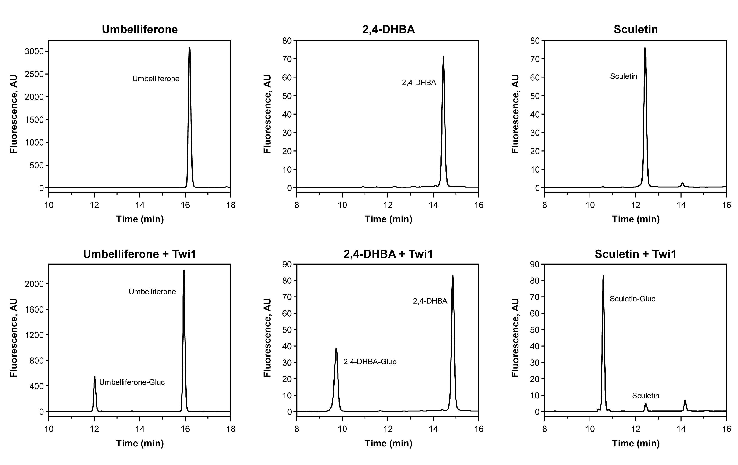
Figure S3

Slide 2
Figure S3
Fig. S3. Twi1 in vitro activity assay with Umbelliferone, 2,4-dihydroxy-benzoic acid (2,4-DHBA) and Sculetin as the sugar acceptor. Upper panels show the chromatographic peaks obtained when substrates were incubated with UDP-glucose in the presence of the Control sample (protein extract from the N. benthamiana leaves agroinoculated with the pGWB8 empty vector). Lower panels correspond to the chromatograms obtained upon incubation with the Twi1 purified recombinant protein expressed in the N. benthamiana agroinoculated leaves. Differential peaks were detected, corresponding to substrates conjugated with glucose. Samples were analysed by HPLC-fluorescence.

